Slide 1
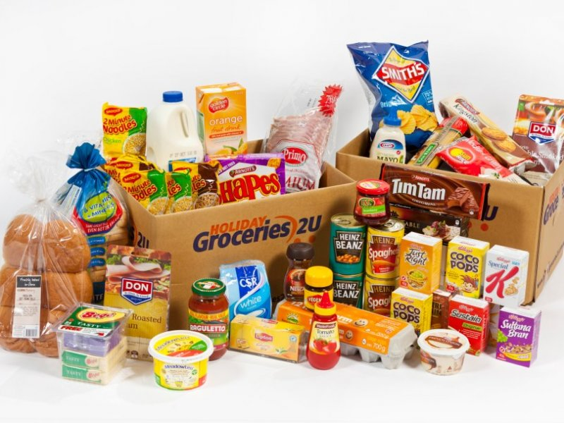
Analysis On Groceries

Slide 2
Problem Statement
One of the big super market in the city given their sales of groceries data to find useful outcome.
From the given data, we are trying to find most frequent item on sales and what other items people buy along with this.
This may boost the sales.

Slide 3
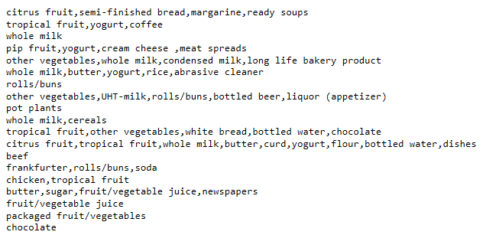
Data Set

Slide 4
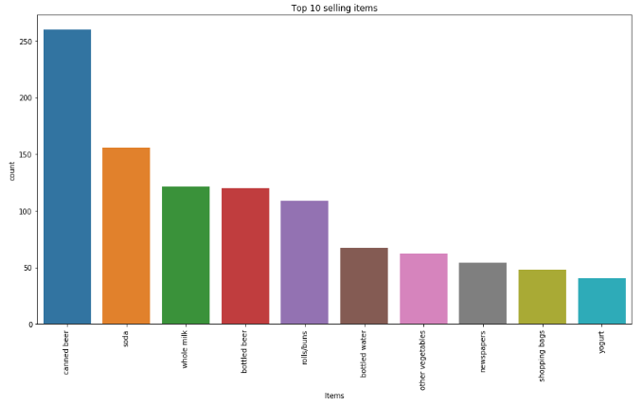
Analysis On Sales

Slide 5
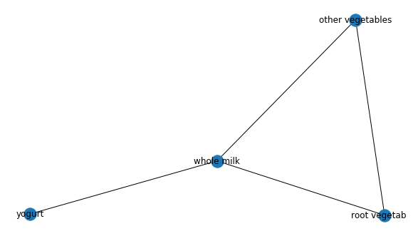
Applying Apriori Algorithm

Slide 6
Conclusion
Whole milk is the bestseller of this super market and it shows association with 3 items- curd, root vegetables and other vegetables.
There are a couple of strategies that the super market can adopt to increase its sales considering the association we have seen between whole milk and its 3 partners.

